Slide 1
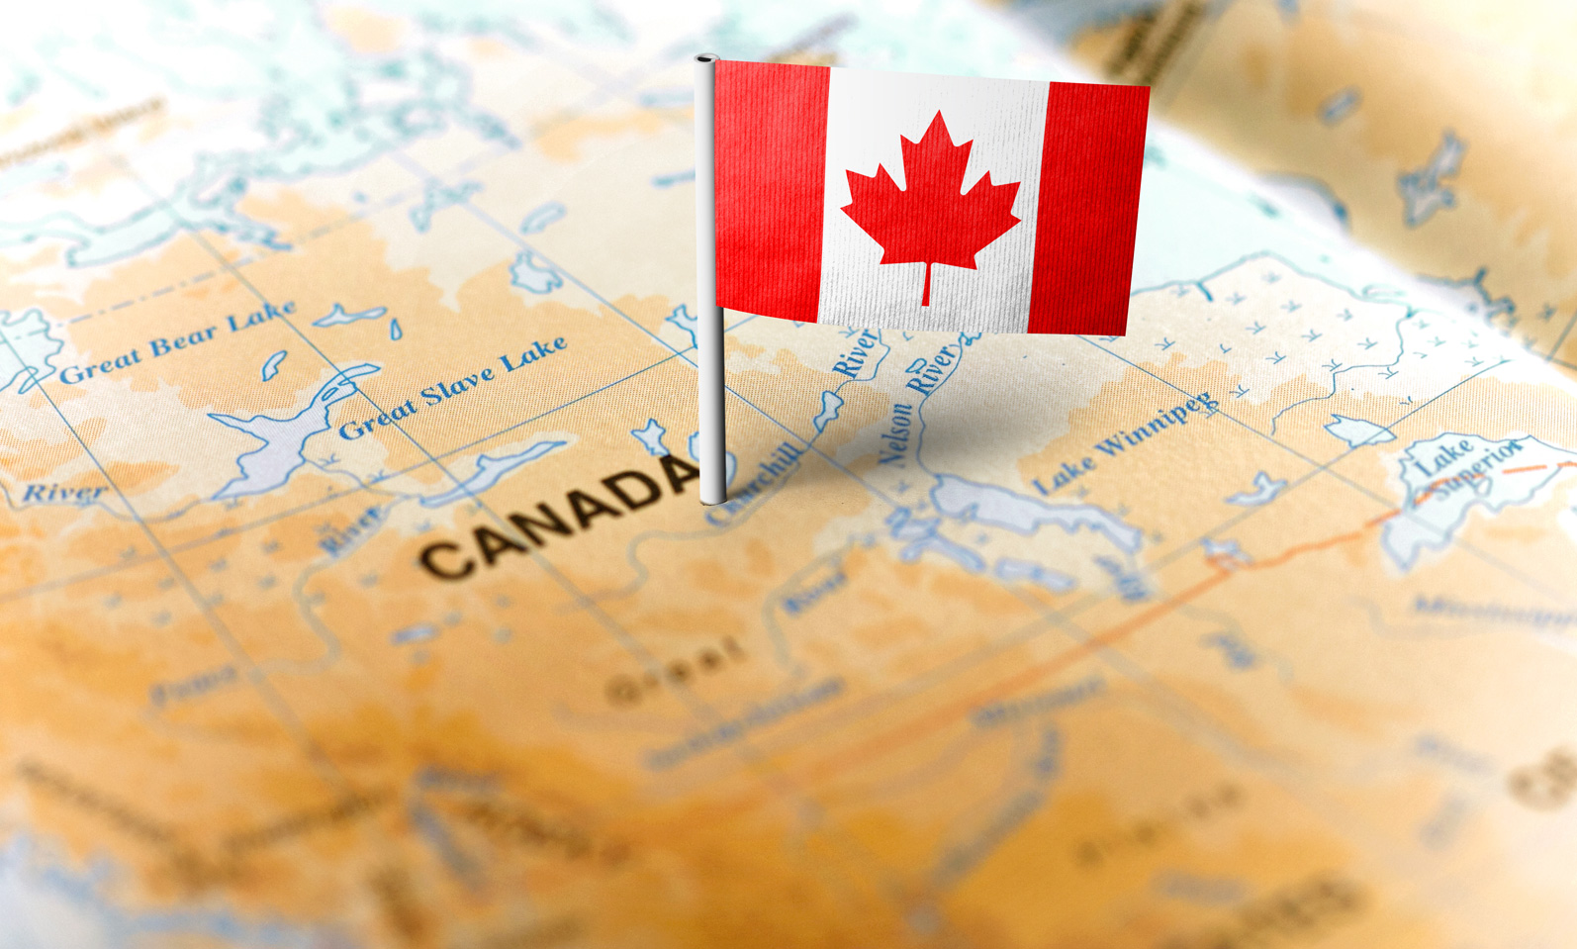
Location Analysis For Launch Of "Winter-Coma" In Canada
Applied Datascience Capstone Project
-- Manika Babbar

Slide 2
Introduction
Background
“Brick and Mortar Retail” has been on the brink of a major apocalypse.
Close to 51,000 retail stores opened in U.S in last 3 years and at the same time almost 42,000 stores closed their doors.
Out of these 9,300 closures were in city of New York which is touted as the world’s leading financial centre and the most financially powerful city in the world.
Ecommerce vs Brick & Mortar
E-commerce is at 16% while in-store is at 4%
Revenue for in-store is 3 times that of online stores
Imminent need to invest and be successful in the retail development industry
Most important decision for a new retail business is “where to open the store?”.
Problem
“Winter-Coma” is a winter wear clothing brand looking to enter Canada. However, owing to the sensitive brick and mortar retail industry status, it wants to perform a through location data analysis before it fixates upon a site to open a store.
“Maximizing sales is a primary objective for retailers, hence, finding the perfect site location that will facilitate both footfall and growth, is of key importance (O'Malley, et al, 1995)”

Slide 3
Data Description
Four different datasets have been used in the analysis.
Weather Station Data
Postal Code Data
Demographic, Census Data
To identify colder region
Features like Temperature, precipitation, location coordinates etc
To select region with better business prospects
Features like Population and income trends
To get the Borough level data
Features like Borough, neighbourhoods
Foursquare API Data
To analyse the Boroughs basis the neighbouring venues
Features like Venues, Venue Categories

Slide 4
Methodology
DBSCAN clustering on location and temperature data from weather dataset to identify colder regions in Canada
Scraping the postal code(Borough level) data from Wikipedia and linking the location coordinates with the help of Geospatial dataset
Utilising Foursquare API data to get the neighbourhood level venue categories
Data Analysis on the demographic, census dataset to select the region with better business prospects
Analysing each area basis the type of neighbourhood

Slide 5
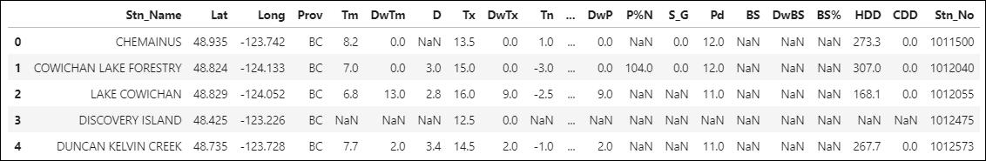
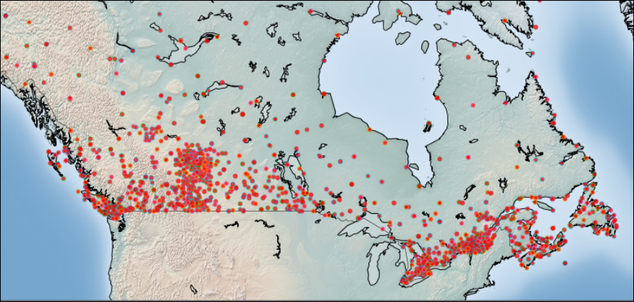
Identifying Cold Regions In Canada
Weather Station data from “Environment Monthly, July’15”
25 Data points for 1341 weather stations spread across Canada
Location coordinates, min. and max. temperature readings, precipitation, snowfall, sunshine etc.
Fig 1: Weather Station Dataset
Location-based data, hence using DBSCAN (Density Based Spatial Clustering of Applications with Noise).
Works best with spatial data with noise
Locates regions of high density that are separated from one another by regions of low density.
Radius of 300 mtrs and min. sample size of 10 taken
Total of 9 clusters and 428 outliers observed
Fig 2: Weather Station Visualisation on map of Canada

Slide 6
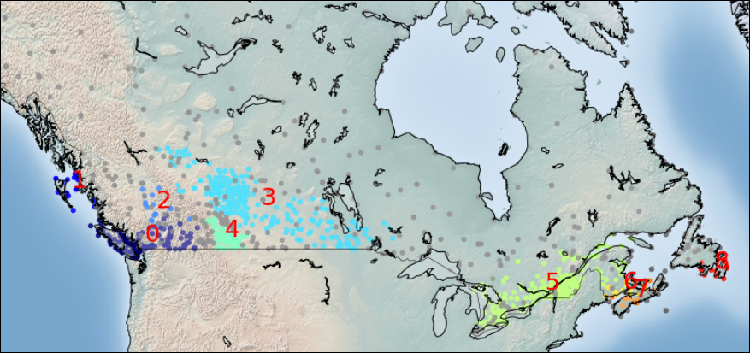
Identifying Cold Regions In Canada
Clusters 5, 3 and 6 are the ones with lowest mean min. temperatures of around -15 °C.
Clusters in the western part are warmer compared to eastern
Avg. min. temperature of western part above 0°C
Clusters in eastern part i.e. 7 & 8 have a min. temperature of -6°C.
Fig 3: DBSCAN Clusters of Weather Stations
With further analysis of data, eastern part seems more suitable owing to following factors:
More no. of weather stations, 266 compared to 215 in western part;
Lower mean of minimum temperature, -16.3°C compared to -13.8°C
Proximity of clusters 6, 7 and 8 which too have low temperatures of -13°C, -10°C and -4°C resp.; Unlike in western part surrounded by clusters with a mean temp of -2°C.
High number of clusters implies more footfalls hence more demand in the vicinity of our product.

Slide 7
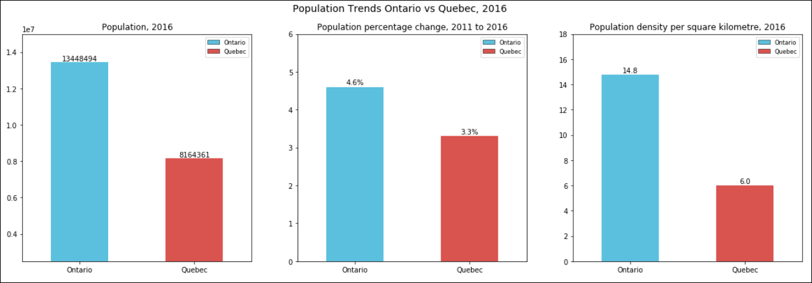
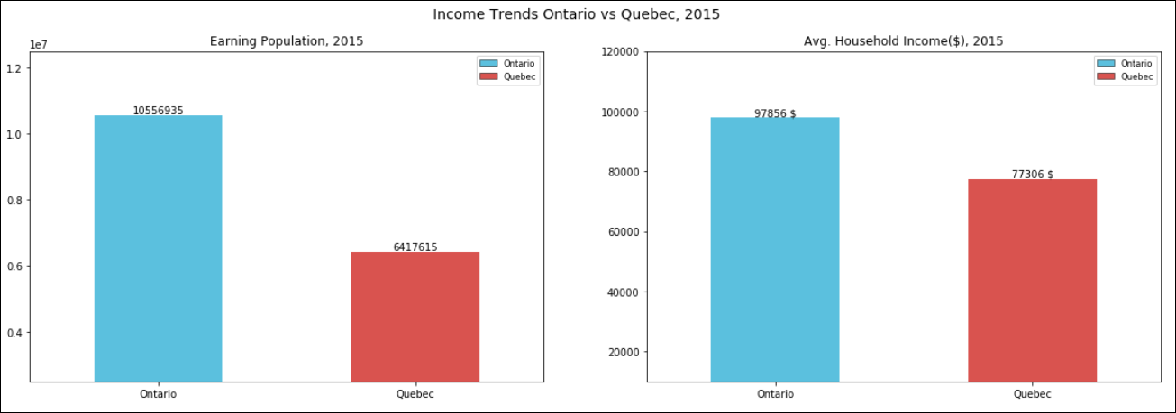


Selecting the Region with Better Business Prospects
Eastern part consists majorly of two regions QC (Quebec) and ON (Ontario). The demographic and census data is further analysed
Ontario has higher population, higher population density hence more coverage for our brand
Ontario has had a higher percentage increase in population over the years indicating a stable and rising economy
Fig 4: Population Trends - Ontario vs Quebec, 2016
Ontario has higher number of earning individuals, indicating more consumers
Ontario has higher average household income than Quebec, indicating better spending potential
Quebec
Ontario
Fig 5: Income Trends - Ontario vs Quebec, 2016

Slide 8
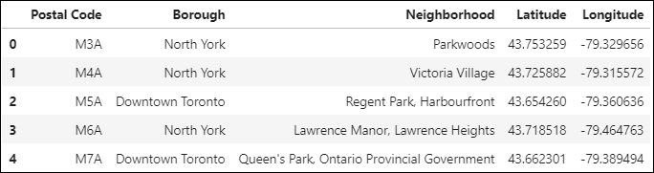
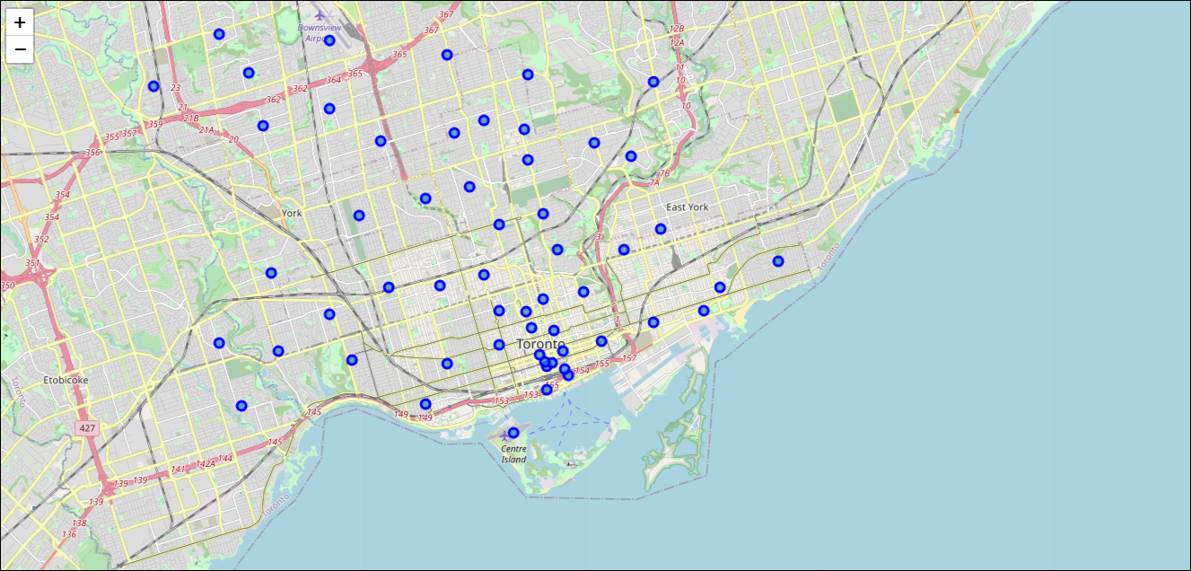
Postal Code Data Analysis for Toronto City
In Ontario, due to limited availability of good quality district level demographic data, we will analyse Toronto City
Postal code data scraped from Wikipedia to extract the Borough level data for Toronto City
103 postal codes in 10 Boroughs around Toronto city
Geospatial dataset used to access the location coordinates of these postal codes.
Fig 6: Postal Code Data with Location Coordinates
DBSCAN clustering used to restrict area of focus
Radius of 400 mtrs and minimum sample size of 5
56 postal codes/areas in 8 Boroughs shortlisted for neighbourhood analysis
Fig 7: Shortlisted postal codes via DBSCAN

Slide 9
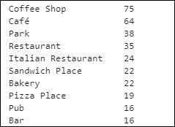
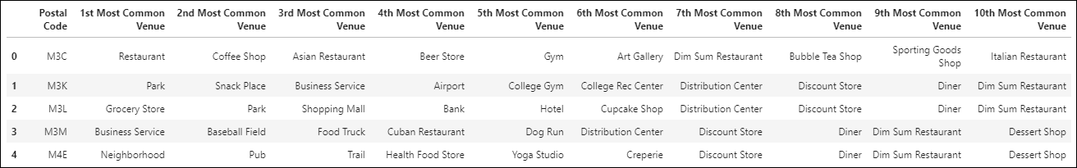
Neighbourhood Data Analysis
Foursquare API data has been used to explore the neighbourhoods. For each area, we can explore the number of venues, their categories. This data helps in understanding the area, whether it’s a residential area or an open field or a market place
Snapshot of the venue category data for these neighbourhoods:
1025 venues in these neighbourhoods in 213 unique categories
Highest number of venues belong to eateries like Coffee shop, café, restaurants, pubs and parks
Boroughs with highest no. of venues belong to mostly M4 and M5 postal codes which belong to Downtown and Central Toronto boroughs
Fig 8: Most Common Venue Categories
Fig 9: Common Venue Categories for each Postal Code

Slide 10
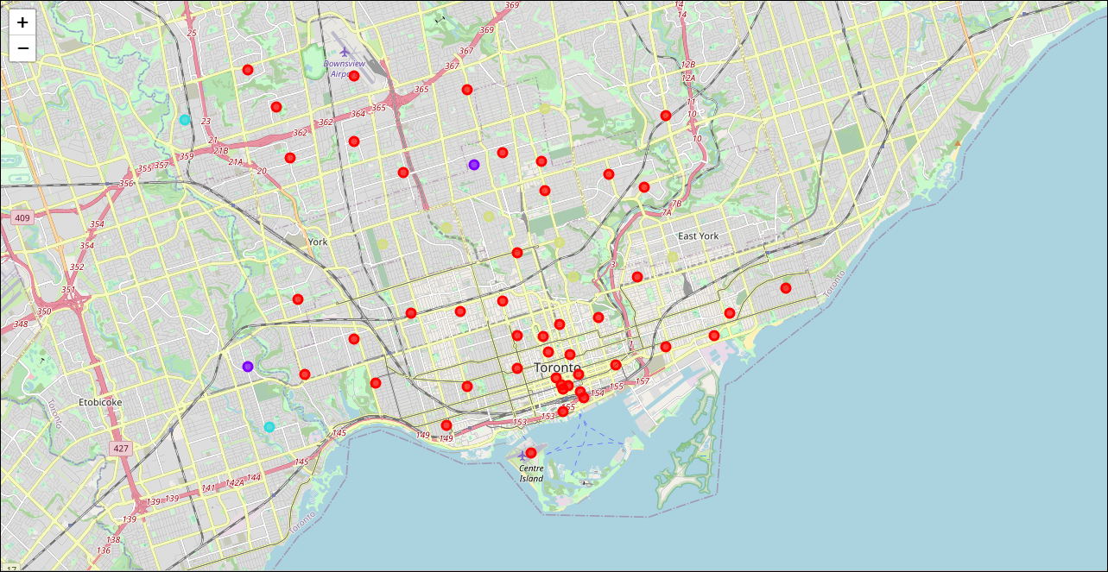
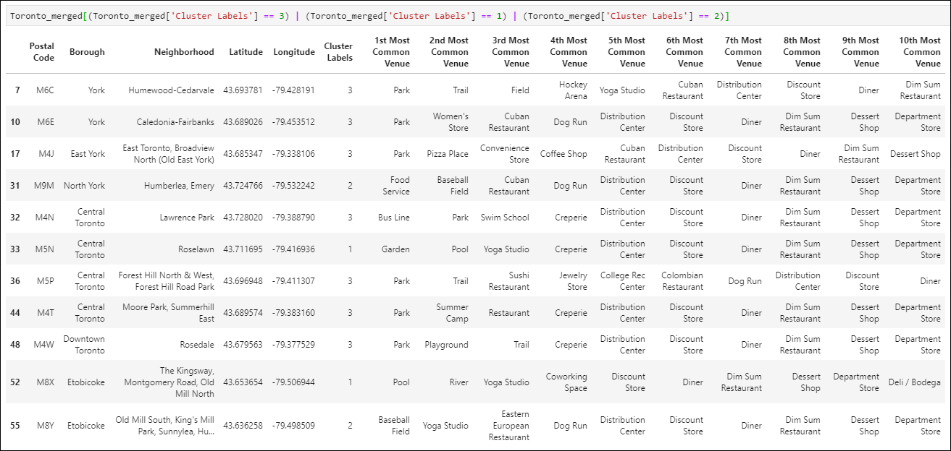
Neighbourhood Data Analysis
Using One hot coding methodology, we will analyse the venue categories in each neighbourhood.
K-Means cluster analysis used to cluster together similar areas basis the venues in the neighbourhood.
Elbow method of reducing the within cluster inertia used to find the best value of K.
Optimum value of “K” for cluster formation comes out to be “4”.
Fig 10: Clusters via K-Means
Red ones are the 45 areas belonging to one cluster while the remaining 11 belong to the other three clusters.
11 areas in three clusters have parks, fields, yoga studios, playgrounds along with one off stores, hence filtering them out
Fig 11: Clusters with parks, playgrounds and one-off stores

Slide 11
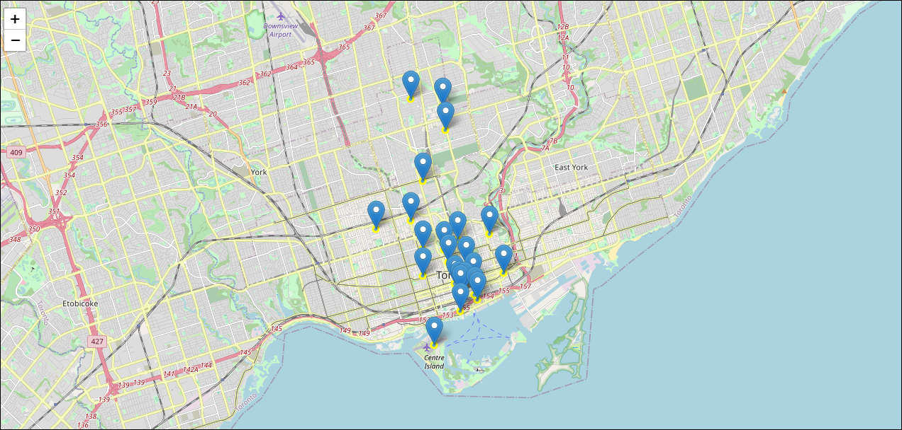
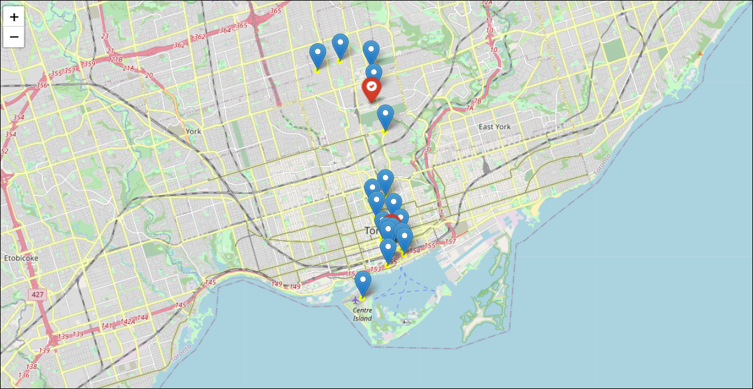
Neighbourhood Data Analysis
23 out of the red areas fall in Toronto Borough
Shortlisted Boroughs:
Central Toronto
Downtown Toronto
Areas spread over a radius of 5 km
DBSCAN clustering used to cluster together high density areas
Fig 12: Areas with relevant venue categories in Central and Downtown Toronto
5 areas of Central Toronto and 13 areas in the high-density cluster of Downtown Toronto. within a radius of 1.5 km.
2 clothing stores and 1 shopping mall in each of these Boroughs
No. of eateries, departmental stores, recreational centres are far more in Downtown.
Presence of Union train station in Downtown , the busiest in Ontario.
Fig 13: High Density areas mapped via DBSCAN

Slide 12
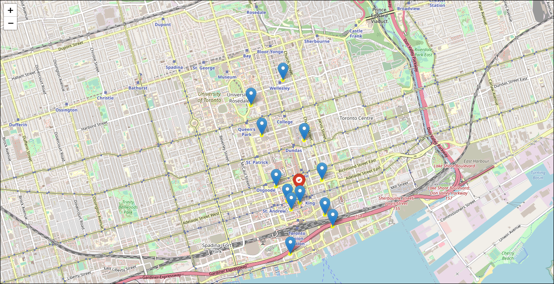
Results
Downtown is the centre of economic activity
High paying capacity individuals
High market potential.
Presence of numerous eating outlets, recreational centres, centre of all activities
High visibility of the brand
High pedestrian traffic
Constant customer pull
Union railway station, a central location
Easy accessibility
Fig 14: Downtown Toronto
*The analysis here focussed on the areas of Customer proximity, easy accessibility and high market potential. This can be further detailed by analysing the market in terms of the nature and presence of competition in the area and availability of a good location with good return on investment.

Slide 13
Thankyou
“Downtown is the main business district of Toronto and it has the retail core presence with over 600 retail stores within 1.5 km radius area.”
- Economic Survey’18
Manika Babbar

